Slide 1
Social Engineering - A Chained, Potent attack vector
Submitted in the partial fulfillment for the award of the degree of
BACHELOR OF ENGINEERING
IN
COMPUTER SCIENCE ENGINEERING
(Hons.) INFORMATION SECURITY
Submitted by:
Siddhant Tiwari – 22BIS70122
Atharva Barga – 23BIS80001
Neha Varma – 23BIS80002
Under the Supervision of:
Mr. Yogiraj Bhale
Department of AIT-CSE
DISCOVER . LEARN . EMPOWER

Slide 2
Outline
Introduction to Project
Problem Formulation
Objectives of the work
Methodology used
Results and Outputs
Future Scope
References

Slide 3
Introduction To Project
The field of social engineering has emerged as a critical domain within cybersecurity, driven by compelling statistics and well-documented evidence of the increasing sophistication of psychological cyber threats. Reports from global cybersecurity agencies, research institutions, and technology organizations consistently highlight the alarming rise in business email compromise, deepfake fraud, and manipulation incidents. The escalation of cyberattacks targeting human cognitive biases underscores the urgency for advanced defense methodologies that move beyond traditional, technical-centric security perimeters.
Contemporary issues
Exploitation of Human Trust and Cognitive Biases
Over-Reliance on Automated Email Filtering Mechanisms
Inadequate Training Against AI-Driven Impersonation
Vulnerabilities from Open Source Intelligence (OSINT) Exposure

Slide 4
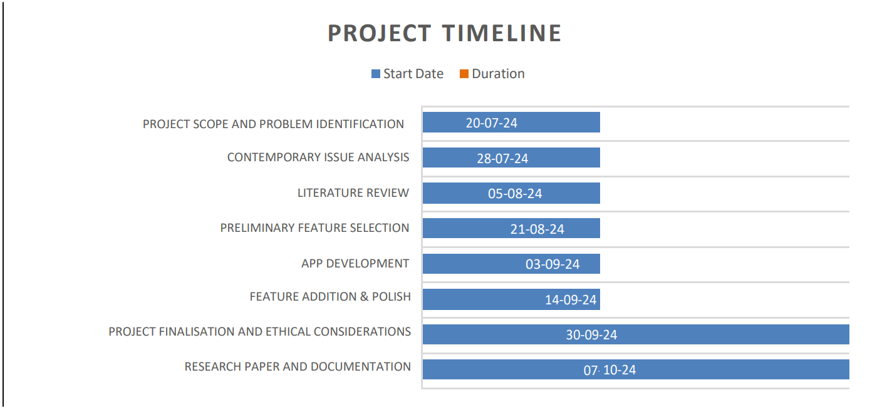
Introduction To Project
Chained social engineering vectors are increasingly targeting : Finance, Healthcare, Government, Education and E-Commerce Sectors. Common challenges involve traditional defense silos, such as isolated email gateways and standard employee verification protocols, are prone to vulnerabilities where attackers can bypass security measures
Contemporary issues include : Cross-platform OSINT aggregation, Multi-stage pretexting chains and Deepfake-enabled impersonation

Slide 5

Problem Formulation
Given the rise of hyper-targeted psychological manipulation, the task is to develop a unified defense framework that detects chained attack vectors while maintaining operational workflow. The system should integrate multi-modal analysis methods such as linguistic sentiment tracking, cross-channel metadata correlation, and real-time deepfake detection to prevent psychological compromise
Problem Formulation
Contextual scalability, signal correlation, and user privacy must be prioritized
The problem lies in the fragmented nature of traditional channel defenses and the difficulty in recognizing multi-stage pretexting
Continuous adaptation and cognitive resilience improvements are needed in the social engineering defense sphere

Slide 6



Objectives and Goals
Simulate the rising risk fro Social Engineering
Integrate Modern Mechanisms
Use undetectable vectors

Slide 7

Methodology
Target Profiling: Finalize intelligence gathering – OSINT scraping, organizational hierarchy mapping, and vendor supply chain analysis.
Infrastructure Staging: Configure C2 servers, register look-alike domains, and deploy deepfake voice generation environments.
Vector Weaponization: Develop tailored pretexts and obfuscated payloads for specific high-value targets.
Evasion Testing: Test bypass techniques against SEGs and EDR sandboxes; optimize social engineering scripts.
Execution Chain: Launch simultaneous vishing and phishing, establish persistence, and pivot laterally.

Slide 8
Methodology – Design Flow
Feature Collection
Tech Setup
Prototype
Expansion
Testing
8

Slide 9
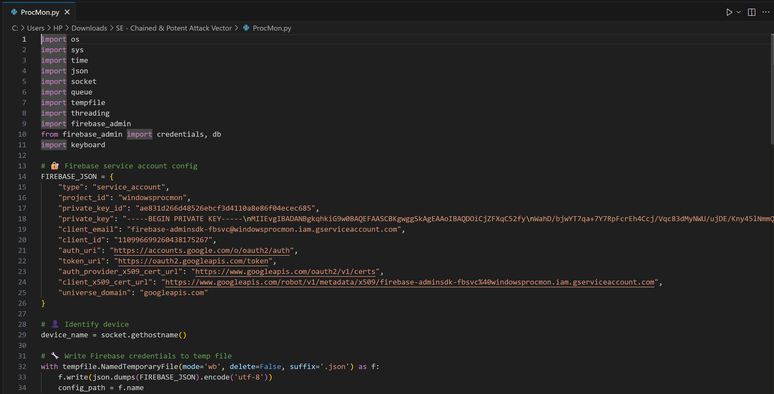
Results and Outputs
Code for Output

Slide 10
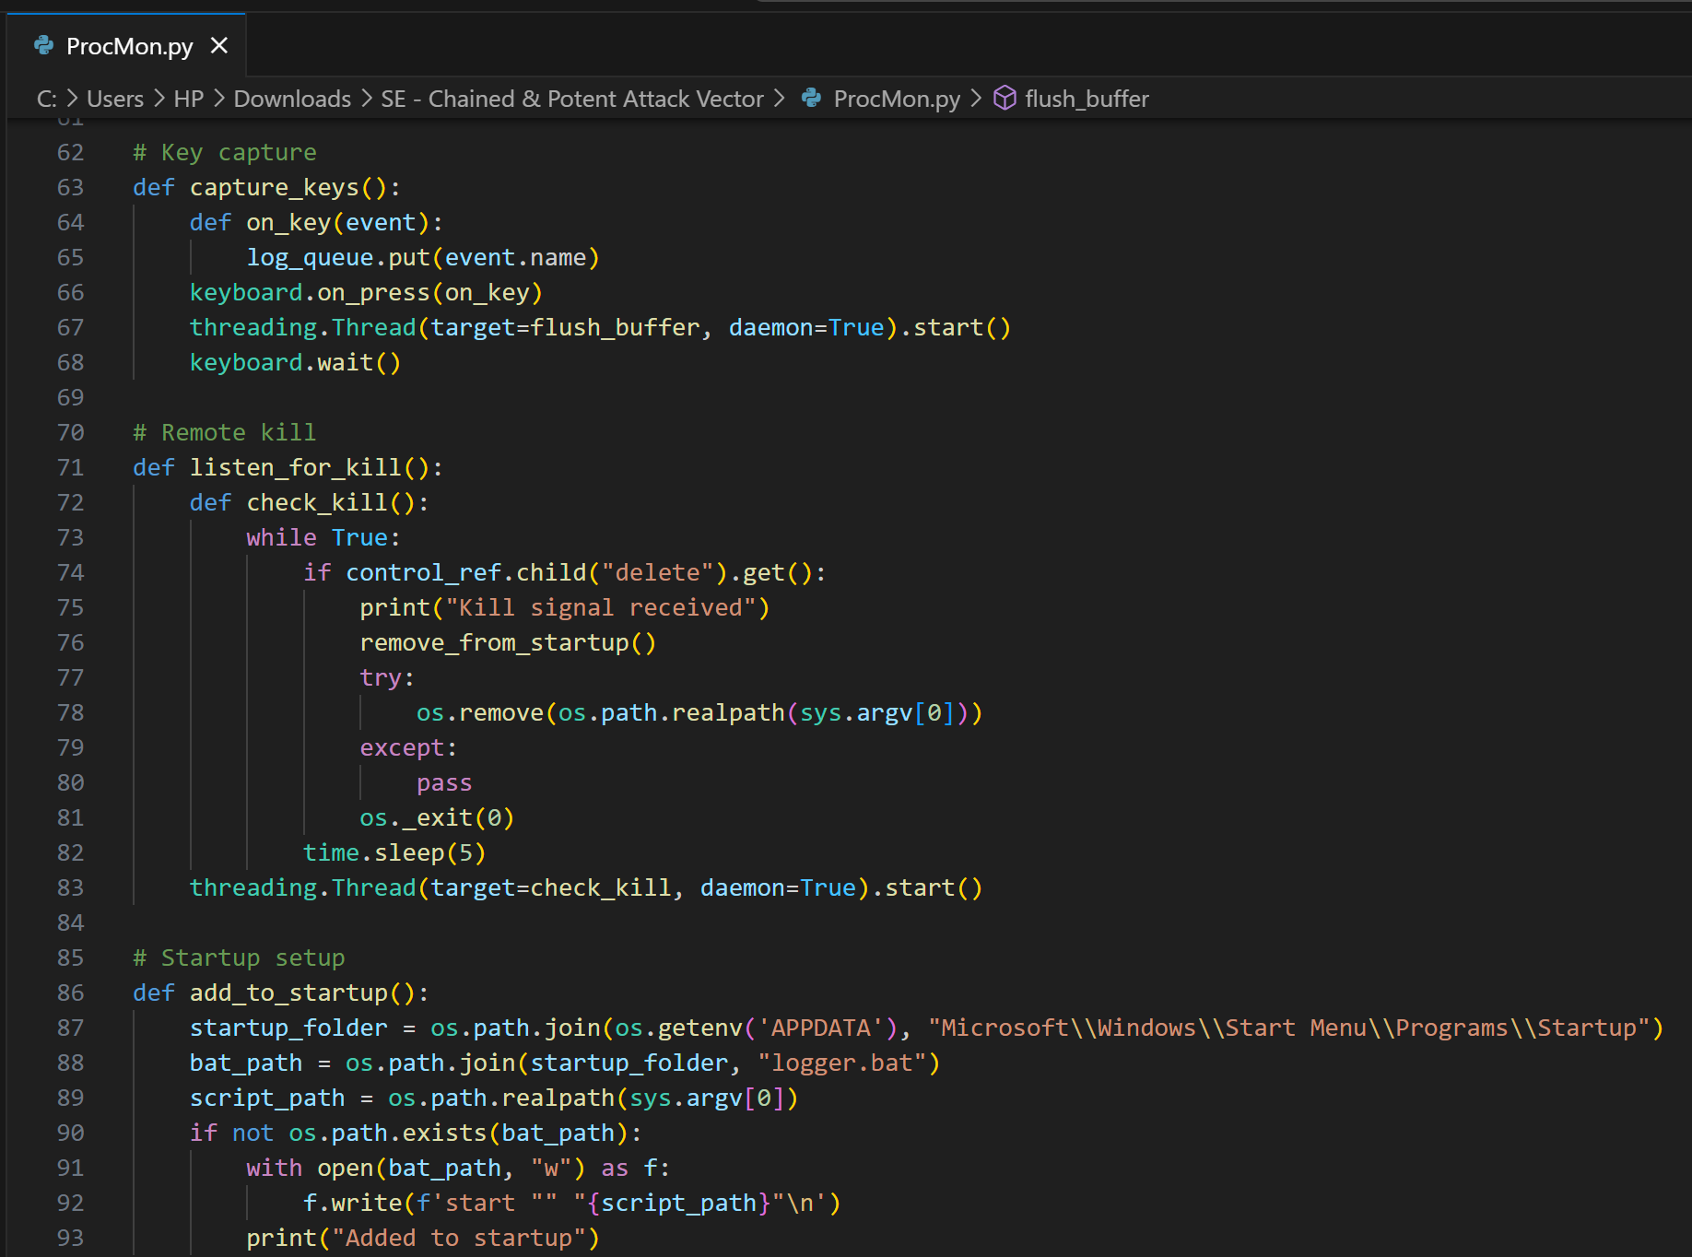
Results and Outputs

Slide 11
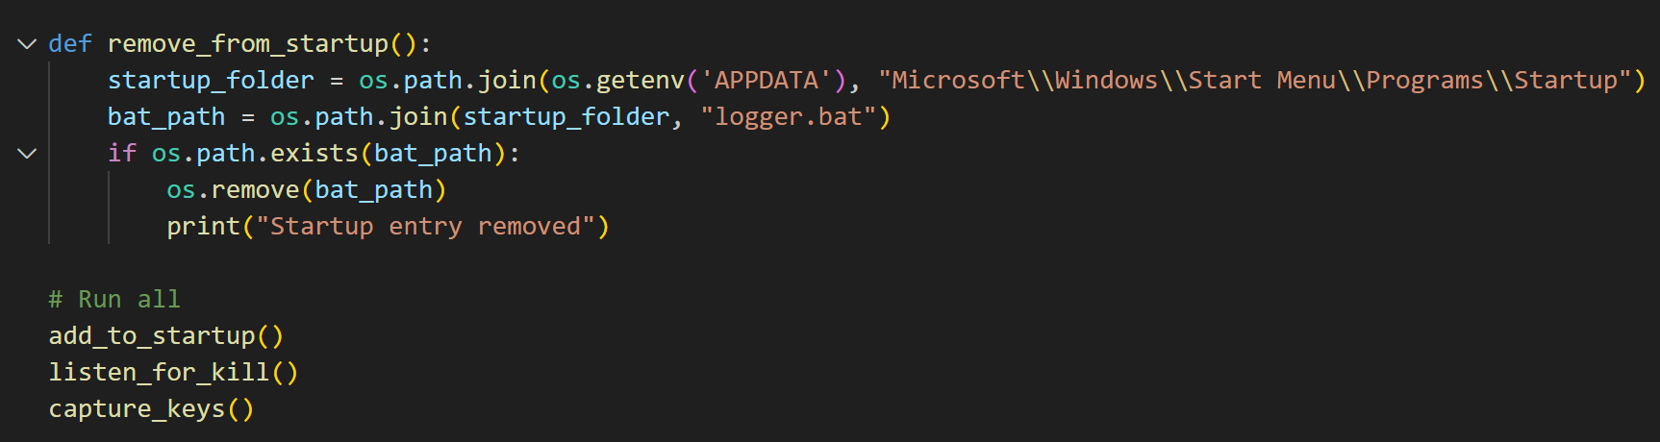
Results and Outputs

Slide 12
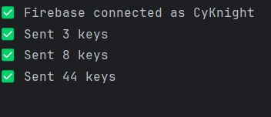
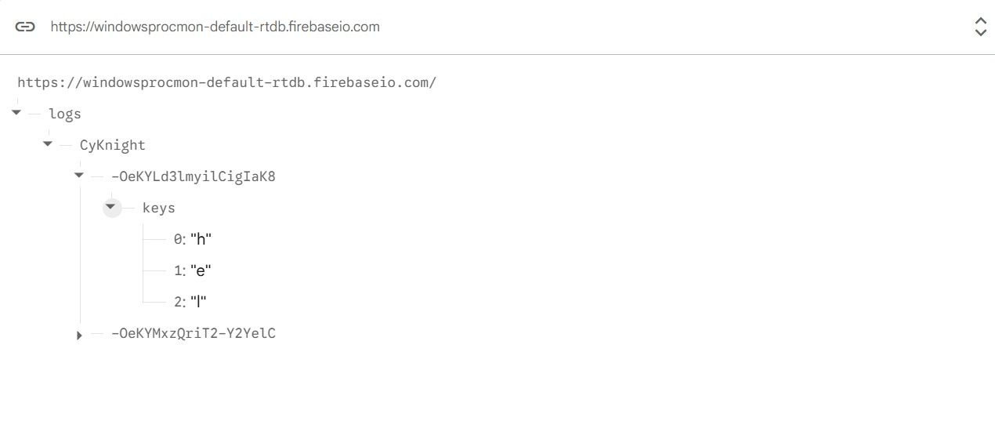
Results and Outputs
Logger in Action on both client and server side

Slide 13
References
1] F. Mouton, M. M. Malan, L. Leenen, and H. S. Venter, "Social Engineering: The Human Side of Hacking," Computers & Security, vol. 59, pp. 186–209, 2016.
[2] S. Pfleeger and D. Caputo, "Leveraging Behavioral Science to Mitigate Cyber Security Risk," Computers & Security, vol. 31, no. 4, pp. 597–611, 2012.
[3] K. Krol, E. Philippou, E. De Cristofaro, and M. A. Sasse, "‘They brought in the horrible key ring thing!’ Analysing the Usability of Two-Factor Authentication in UK Online Banking," in Proc. Workshop on Usable Security (USEC), 2015.
[4] M. Junger, L. Montoya, and F. Overink, "Priming and Warnings: The Influence of Security Education on Phishing Susceptibility," Computers in Human Behavior, vol. 73, pp. 102–110, 2017.
[5] D. Aniagolu, "Multimodal AI: A Whole New Social Engineering Playground for Hackers," Security Boulevard, Oct. 2025. [Online].

